Slide 1
Java Tutorials
Primitive Data Types And declaration

Slide 2
Primitive Data Types
Primitive [prim-i-tiv] adj.
being the first or earliest of the kind or in existence, especially in a nearly age of the world.
Statically-typed:
All variables must first be declared before they can be used.
int intExample;
char charExample;
The 8 primitive data types supported by Java are:
byte, short, int, long float double, boolean and char

Slide 3
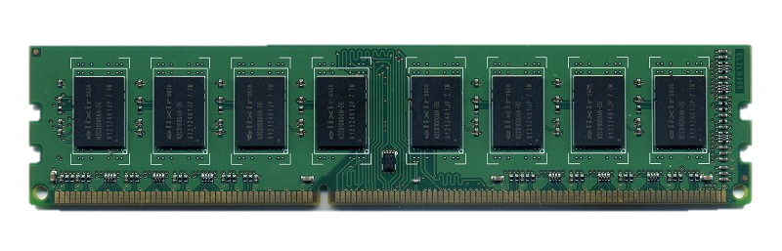
byte
By default, the byte data type is a 8-bit signed two's complement integer.
7
6
5
4
3
2
1
0

Slide 4

byte
By default, the byte data type is a 8-bit signed two's complement integer.
${0∗2}^{0}+{0∗2}^{1}+0∗2^{2}+ …+{0 ∗ 2}^{6}=0$
${1∗2}^{0}+{1∗2}^{2}=5$
${1∗2}^{0}+{1∗2}^{1}+1∗2^{2}+ …+{1 ∗ 2}^{6}=127$ (maximum value)
${1∗−2}^{7}=−128\text{(}\text{minimum} \text{value}\text{)}$
7
6
5
4
3
2
1
0

Slide 5
byte
byte a = 127;
byte b = 1;
byte failed = 128; // won’t compile
System.out.println(a+b); //128

Slide 6
int
By default, the int data type is a 32-bit signed two's complement integer.
Minimum value of -2³¹
Maximum value of 2³¹-1
int a = 1
int b = 2
7
6
5
4
3
2
1
0
7
6
5
4
3
2
1
0
7
6
5
4
3
2
1
0
7
6
5
4
3
2
1
0

Slide 7
short / long
short
16-bit signed two's complement integer
minimum value of -32,768
maximum value of 32,767
long
64-bit signed two's complement integer
minimum value of -2⁶³
maximum value of 2⁶³-1

Slide 8
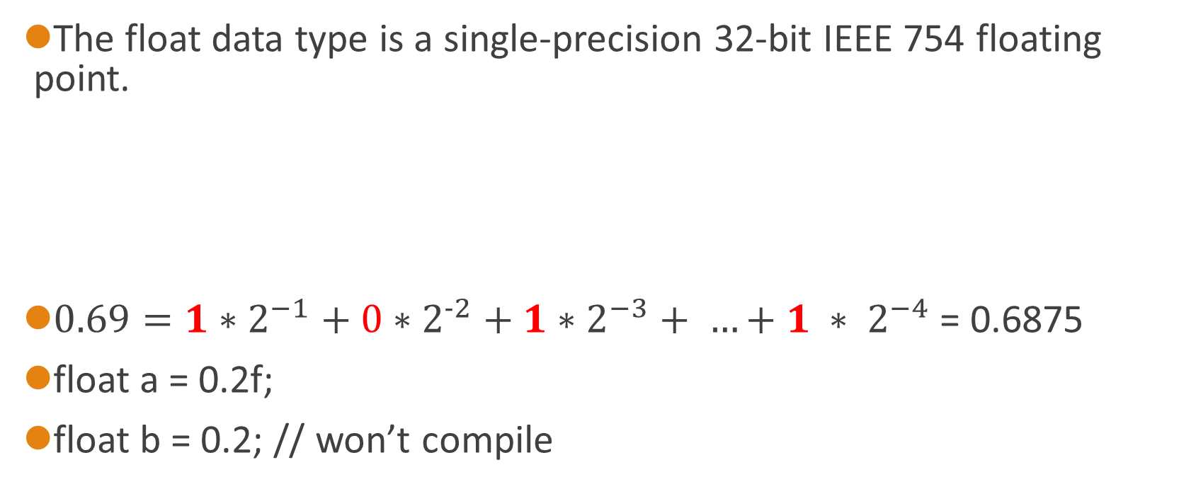
float
The float data type is a single-precision 32-bit IEEE 754 floating point.
$0.69={1∗2}^{−1}+{0∗2}^{−2}+1∗2^{−3}+ …+{1 ∗ 2}^{−4}$ = 0.6875
float a = 0.2f;
float b = 0.2; // won’t compile
3
2
1
0
-1
-2
-3
-4

Slide 9
double
The double data type is a double-precision 64-bit IEEE 754 floating point.
7
6
5
4
3
2
1
0
7
6
5
4
3
2
1
0

Slide 10
double
double a = 0.2;
double b = 0.2d;
double c = 0.2f; //compiled, but print as “0.20000000298023224”

Slide 11
boolean
The boolean data type has only two possible values: true and false.
boolean b1 = true;
boolean b2 = false;

Slide 12
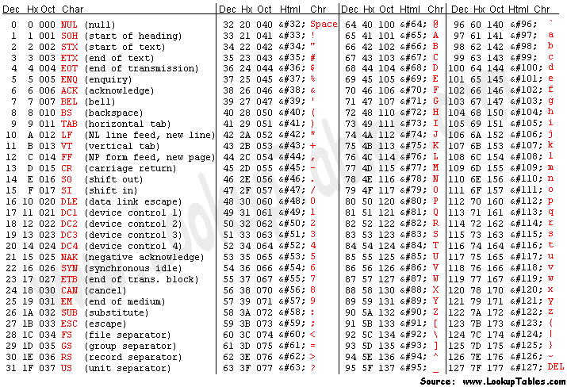
char
The char data type is a single 16-bit Unicode character.
char a = 'A';
char inta = 65;
char a = 'AB'; // this won’t compile.

Slide 13
Variable Declaration
char
tmpChar
=
'A';
Data type
Name
Assigned
Real value

Slide 14
Variable Declaration
Assigned
char
tmpChar
=
'A';
tmpChar
A
0x5566

Slide 15
Variable Declaration
char
tmpChar
=
'A';
tmpChar
'A'
tmpChar
=
'B';
0x056
Statically-typed
Assigned
'B'
0x183

Slide 16
Variable Declaration
char
tmpChar
=
'A';
Data type
Real value

Slide 17
Variable Declaration
boolean b1 = 1;
float f1 = 1d;
double d1 = 1.0d;
d1 = 2.0d
d1 = 1
char c1 = 65
c1 = 'A'
c1 = '65'

Slide 18
Operator
+
double d = 1.0;
int i = 1;
int/double p = d + 1; //?
+
char c = ‘A’;
int i = 1;
int/char p = c + 1 //?

Slide 19
Operator
Operator /
double d = 3.0;
int i = 2;
double/int p = d / i;
Operator /
int d = 3.0;
int i = 2;
double/int p = d / i;

